Slide 1

Chrome Extension for Detecting Phishing Websites
Presentation by:
Mubeena Nazar
Roll no:41
S3 MCA

Slide 2

Introduction
Relevance of my topic
Existing System
Literature Review
Interface Diagram
Data flow Diagram
Use case Diagram
Live demo
Requirements
Time Line
Future Scope
Reference
OVERVIEW

Slide 3


Introduction
Phishing attacks are the practice of sending fraudulent communications that appear to come from a reputable source.
The goal is to steal sensitive data like credit card and login information, or to install malware on the victim’s machine.

Slide 4

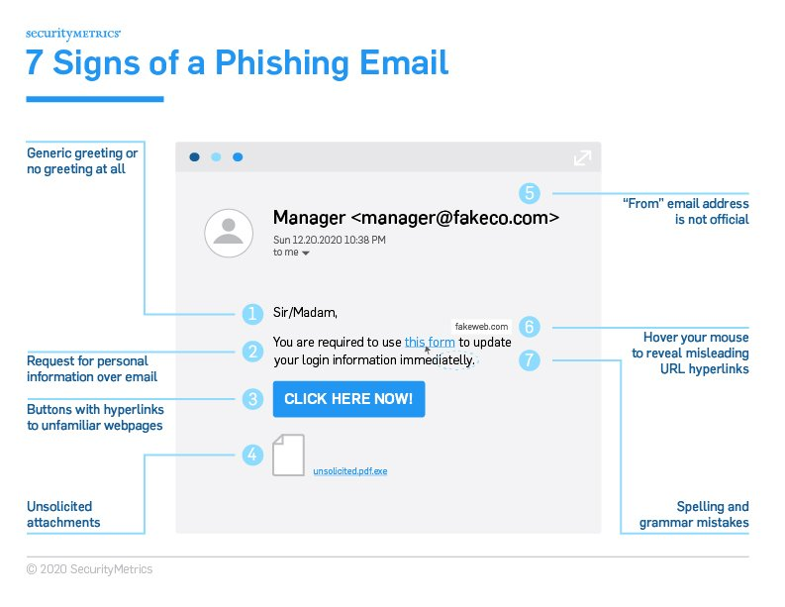
Ways to Prevent Phishing Attacks
Relevance of my topic
Don’t give your information to an unsecured site
Rotate passwords regularly
Don’t ignore those updates
Install firewalls
Don’t be tempted by those pop-ups
Don’t give out important information unless you must
And many more..

Slide 5


Relevance of my topic
Chrome Extension for Detecting Phishing Websites
Easier way
More Easier way
use a website for detection of phishing
TO ADD AS A CHROME EXTENSION

Slide 6

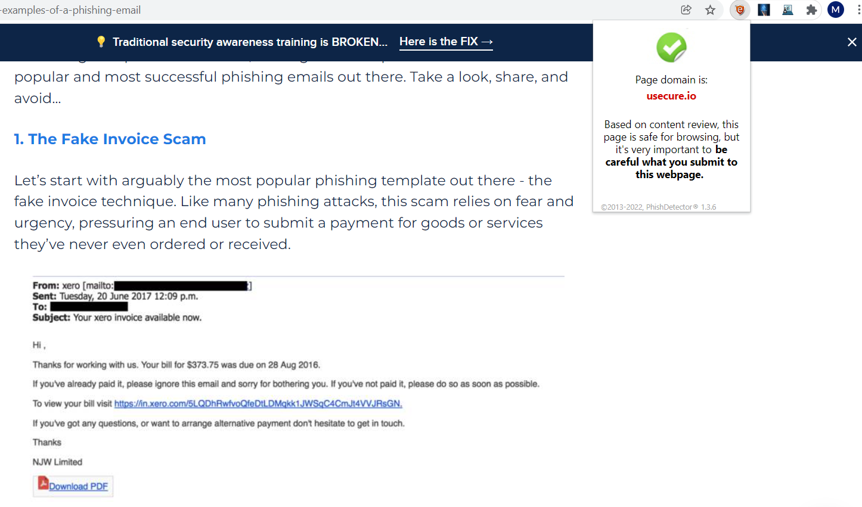

Existing System
1) PhishDetector - True Phishing Detection

Slide 7
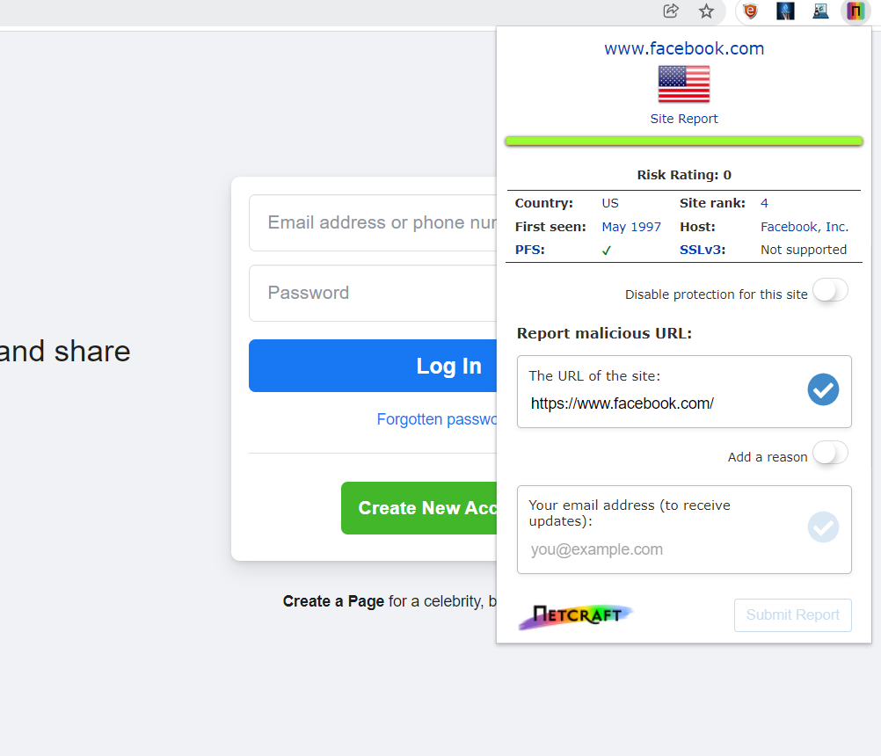

Existing System
2) Netcraft Extension

Slide 8
Literature Review
Detection and classification of phishing websites
Link : https://www.peertechzpublications.com/articles/TCSIT-6-140.php
Inferences:
There two approaches that are typically used in detecting phishing websites blacklist based approach and heuristic-based approach
This paper uses the classification rule which is one of the induction technique in datamining as the paper is chooses to go with heuristic based approach
This paper suggest how to use the machine learning technique to classify the Phishing website as the usage of blacklist to identify the phishing website is not effective in zero hour attack

Slide 9
Literature Review
Chrome Extension for Detecting Phishing Websites
Link: https://www.irjet.net/archives/V7/i3/IRJET-V7I3590.pdf
Inference:
This paper proposed a chrome plugin that automates the job of detecting and overcoming traditional methods by using a machine learning algorithm
The paper utilizes the Random Forest discriminative classifier for detection of phishing website.

Slide 10
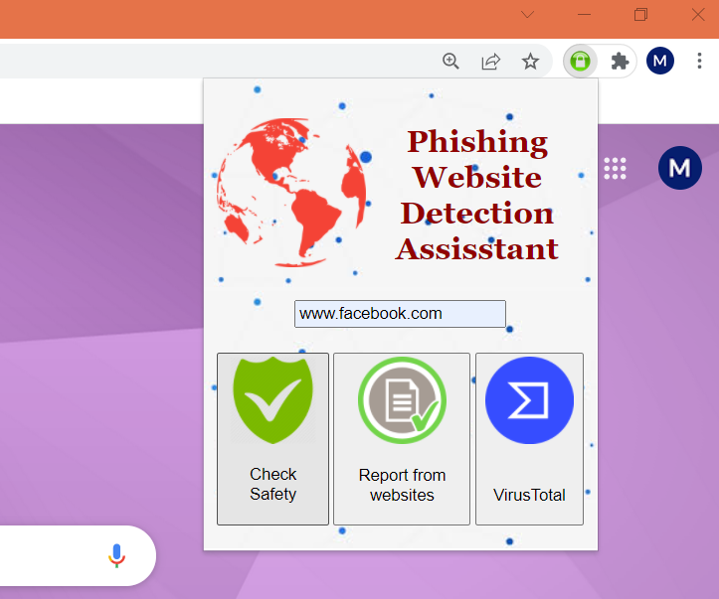
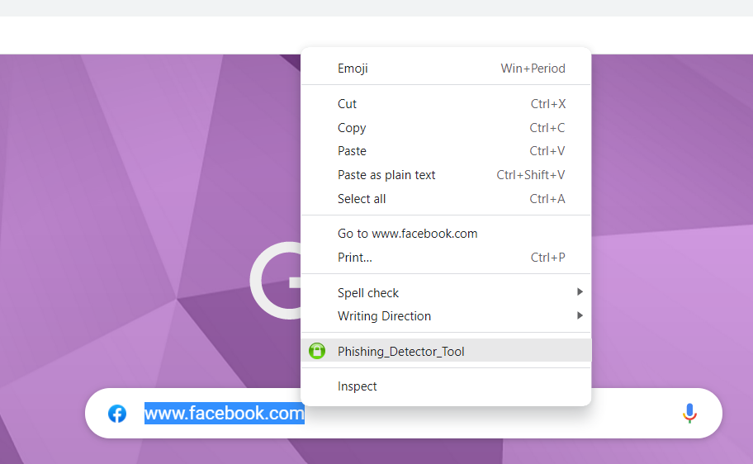
Interface Design

Slide 11
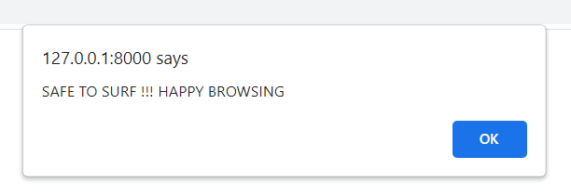
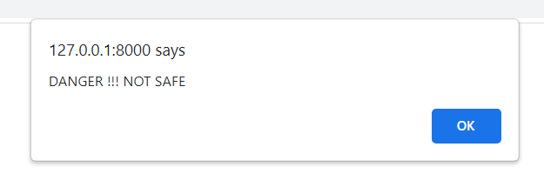
Interface Design
1. Alert Box
Eg : www.facebook.com
Eg : api.interfacecache[.]com

Slide 12
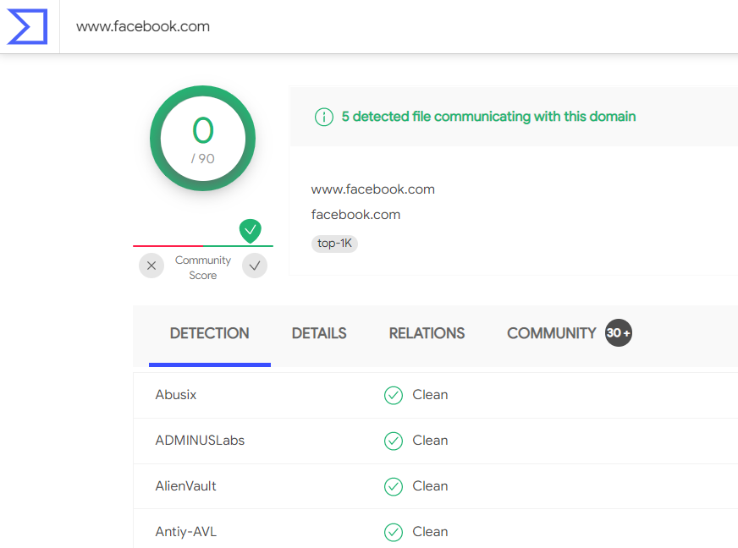

Interface Design
2 . Integrated Platform
3 .Report from Virus Total

Slide 13
Data Flow Diagram
Client enters URL
Chrome extension fetches URL
Extraction of URL features or attributes
Result Legitimate/Phishing Website
Database Collection (connecting to multiple external website)

Slide 14


Use case Diagram
Add Extension
Store Whitelist
User
Check
Store blacklist
Phishing System
Context Menu
Store Previous history
Alert user
Report of the result
Provide Report

Slide 15

Live Demo
Let’s see the project now !!!

Slide 16

Requirements
HARDWARE REQUIREMENTS
Computers equipped with a Pentium 4 processor or higher
Approximately 100MB of free hard drive space
128MB of RAM
Web Browser
Internet Connection
SOFTWARE REQUIREMENTS
WINDOWS 7 or higher
Python 3.6.0 or higher
Visual Studio Code
Django
HTML
JavaScript

Slide 17

Advantages
Reduces security risks
More user friendly
The computation time is very short
Using multiple websites for better results
Detailed site report
Detection by hiding the users identity from phishers.

Slide 18

Disadvantages
Results are not 100% accurate
Relies on external websites
Working offline is not possible

Slide 19
Time Line
Implementation
begins
1st assessment meeting
Connected python as backend for API
PROJECT COMPLETED
Topic Finalised
Literature Review
20-12-21
21-12-21
22-12-21
02-01-22
12-01-22
13-01-22
21-01-22
29-01-22
03-02-22
09-02-22
10-02-22
Abstract
Design Approved
Chrome Extension developed
Added context
Menu
Added more features

Slide 20


Work Level
Abstract
Literature Review
Design
Implementation
Report

Slide 21

Future Scope
IP addresses, links, emails etc.. may also be included in detection
Automate detection process
Extract features from URLs and pass it through the various classifiers.

Slide 22

Reference
A review on phishing website detection using machine learning: https://www.researchgate.net/publication/352785109_a_review_on_phishing_website_detection_using_machine_learning
Chrome extension for detecting phishing websites: https://www.irjet.net/archives/v7/i3/irjet-v7i3590.pdf
Detection and classification of phishing websites : https://www.Peertechzpublications.Com/articles/TCSIT-6-140.Php
Framework for detection and prevention of phishing website using machine learning approach: https://www.Bibliomed.Org/mnsfulltext/197/197-1599115293.Pdf?1640007654

